Slide 1
NLP BASICS
Week 01

Slide 2
SESSION AGENDA
Basics of NLP
Pre-processing steps
Language Models
Case Study

Slide 3
TOPICS
Introduction to Natural Language Processing
Pre-processing: Tokenization, Stop words, Normalization, Stemming and Lemmatization
Bag of Words and Tf-idf features
Language model
N-grams

Slide 4
WHAT’S NEW IN THE AI WORLD ?

Slide 5
SESSION AGENDA
Basics of NLP
Pre-processing steps
Language Models
Case Study

Slide 6
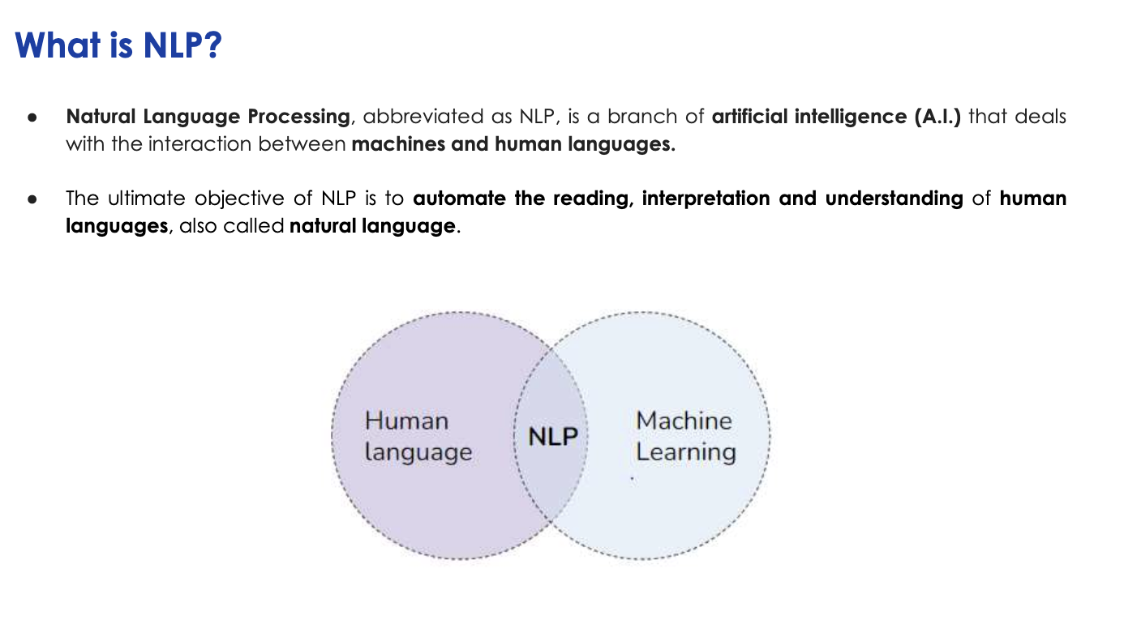

Slide 7
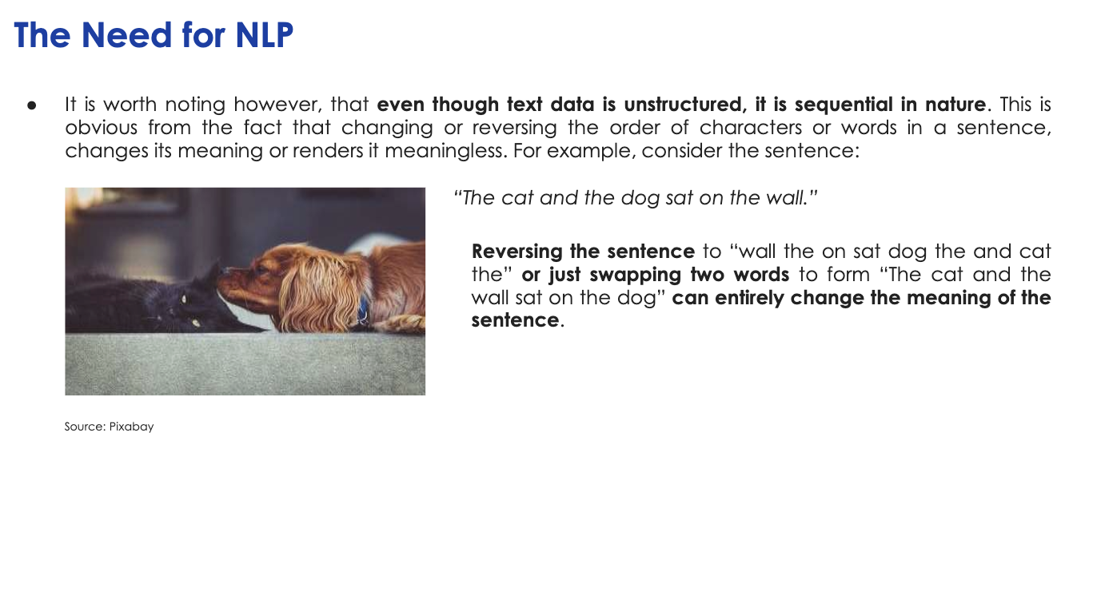

Slide 8
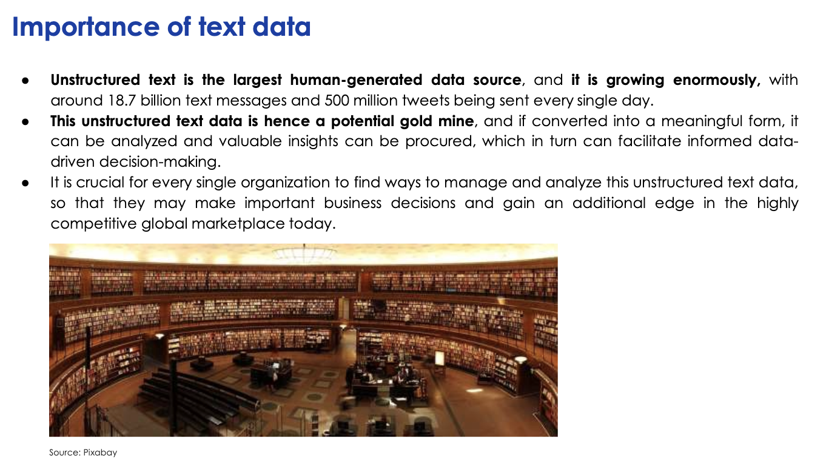

Slide 9
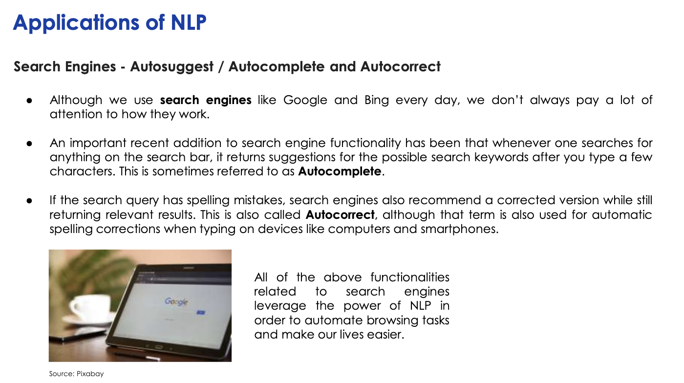

Slide 10
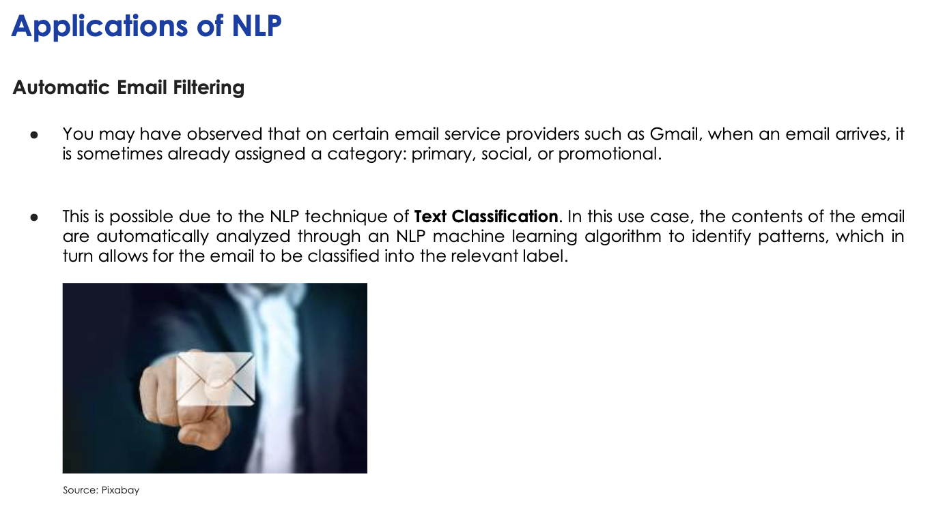

Slide 11
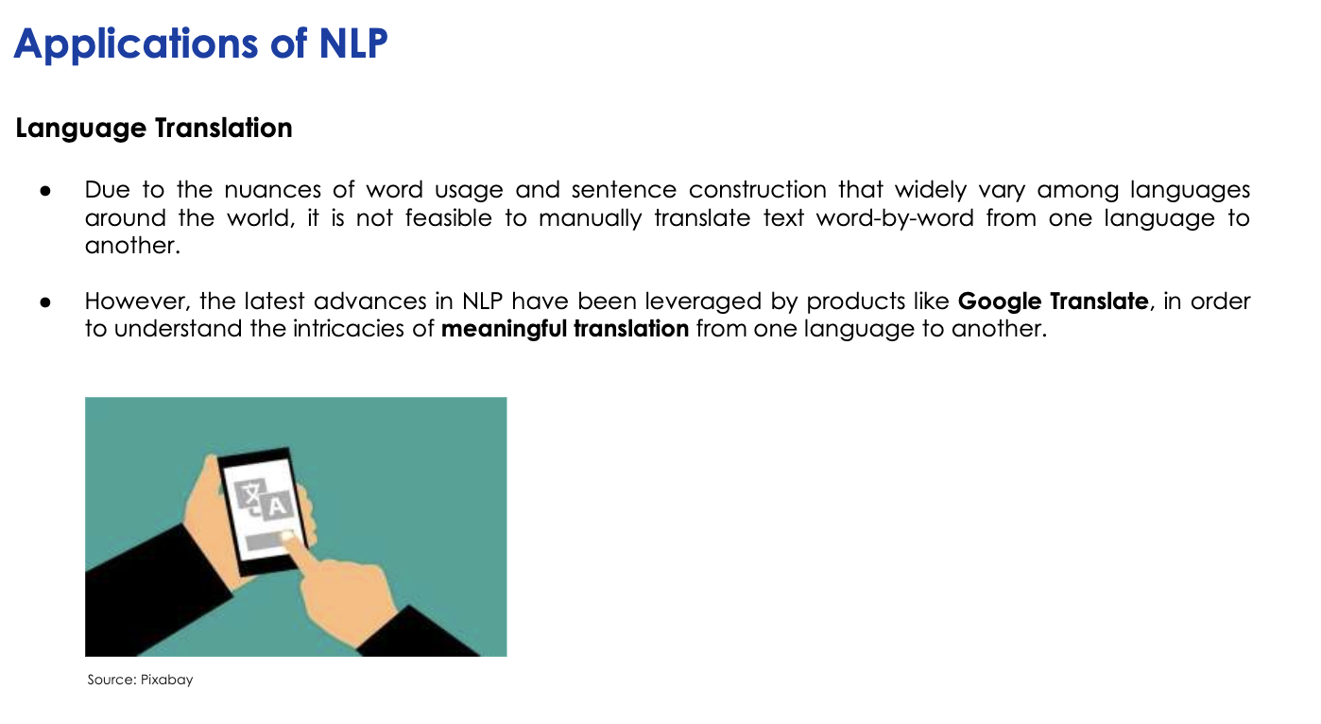

Slide 12
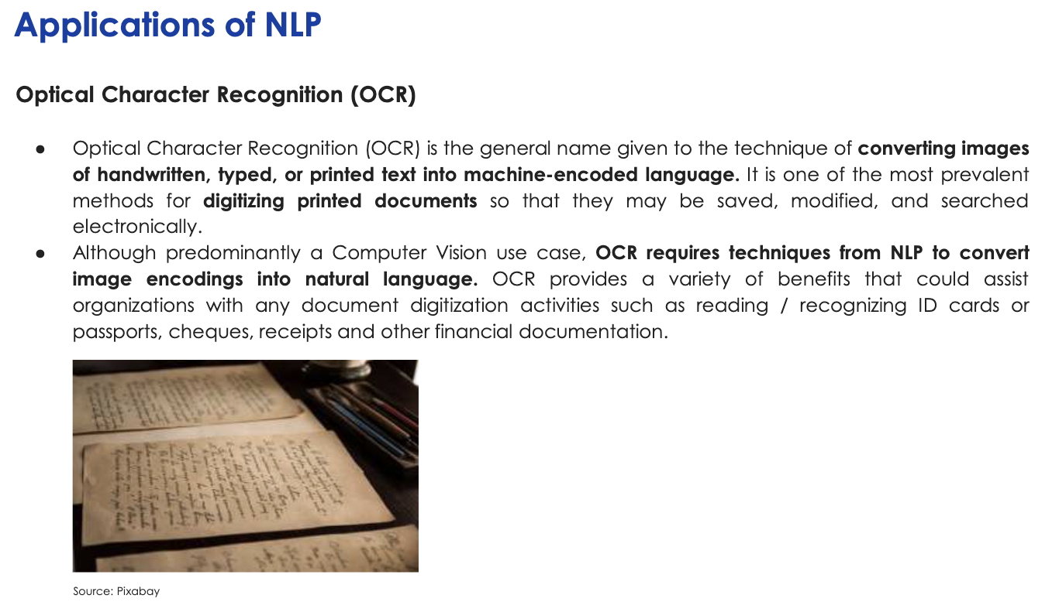

Slide 13
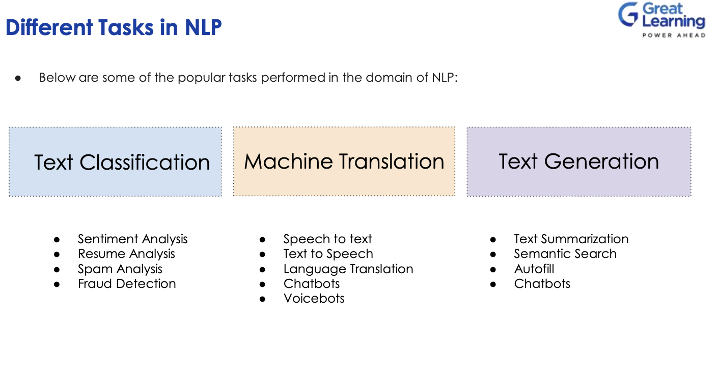

Slide 14
WHY IS NLP HARD ?

Slide 15
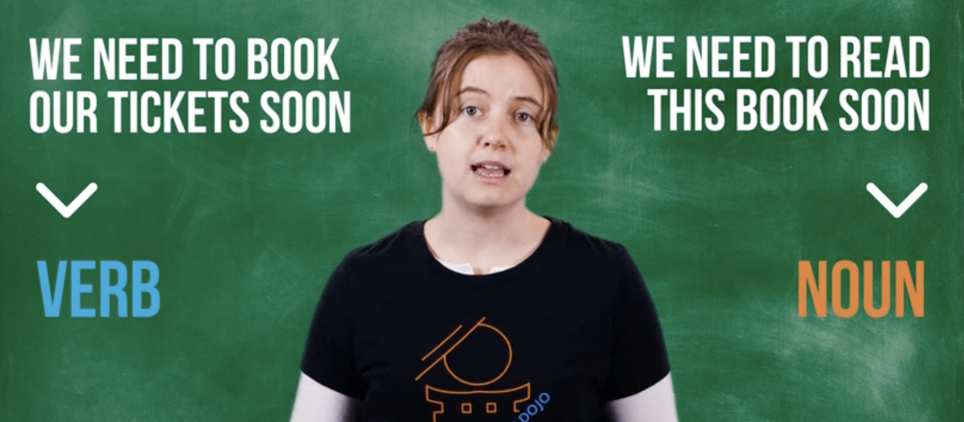

Slide 16
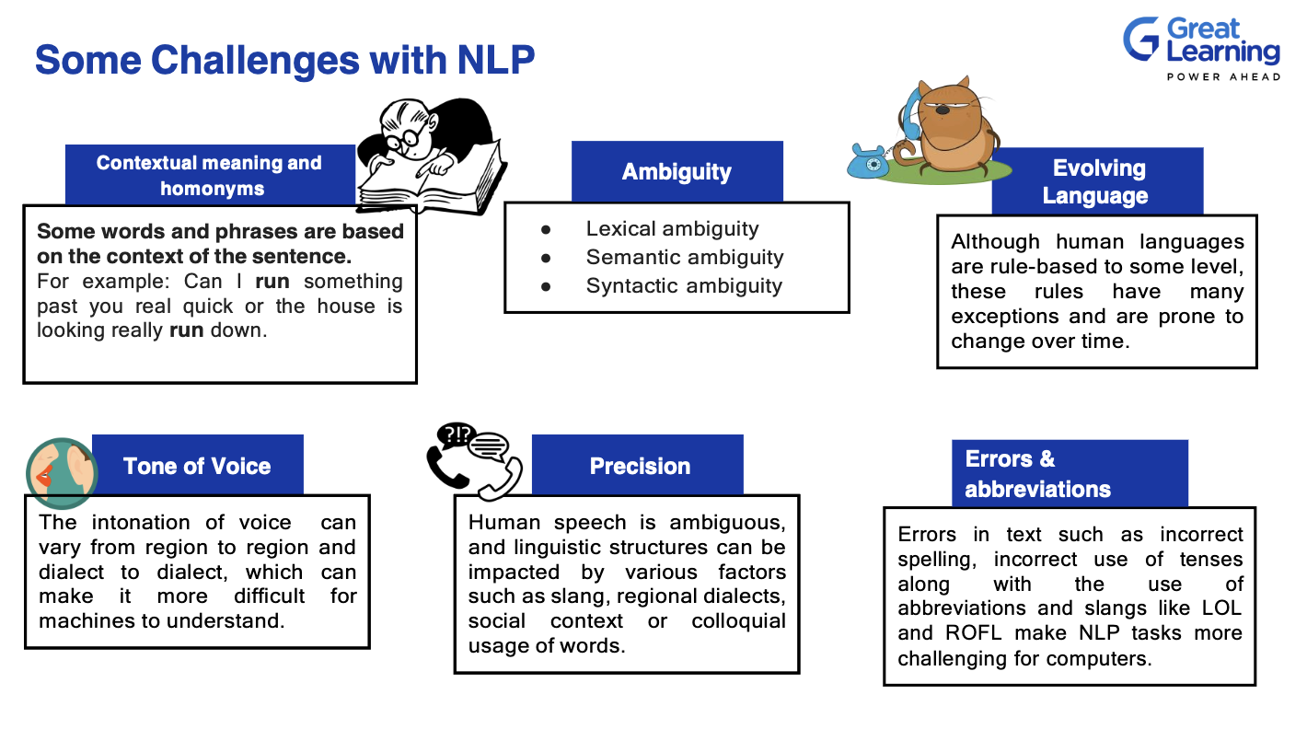

Slide 17
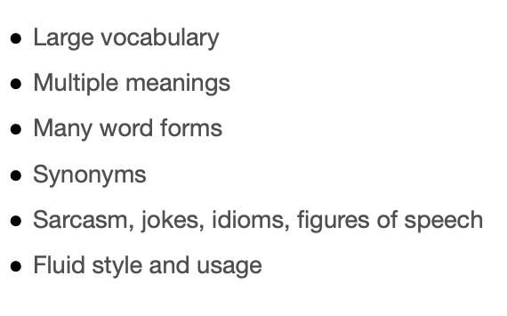
WHY IS NLP HARD

Slide 18
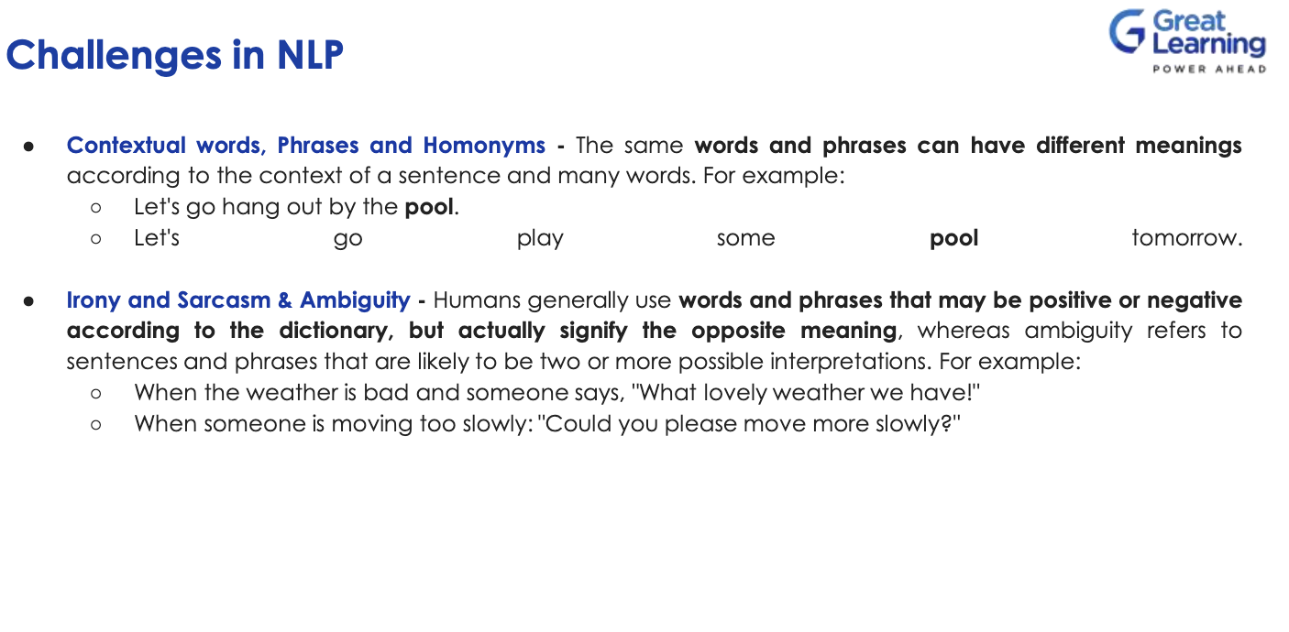

Slide 19
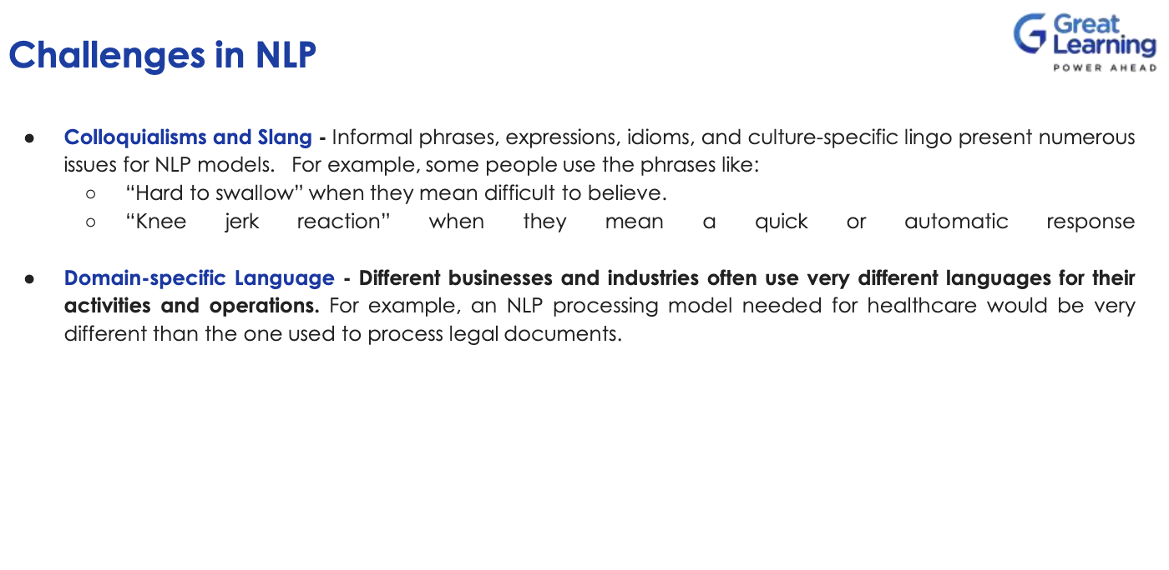

Slide 20
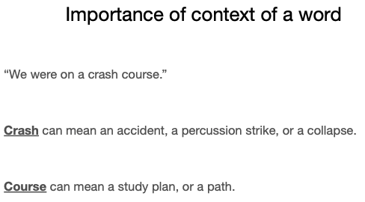
WHY IS NLP HARD
Aryan khan Example –
Lets have a blast – whatsapp chat based on which Narcotics bureau tried to implicate him falsely

Slide 21
WHY IS NLP HARD
Languages are changing everyday, new words, new rules, etc.
The number of tokens is not fixed. A natural language can have hundreds of thousands of different words, new words are created on the fly.
Words can have different meanings depending on context, and they can acquire new meanings over time (apple(a fruit), Apple(the company)], they can even change their parts of speech(Google --> to google).
Every language has its own uniqueness. Like in the case of English we have words, sentences, paragraphs and so on to limit our language. But in Thai, there is no concept of sentences.

Slide 22
PRE-PROCESSING STEPS

Slide 23
JARGONS

Slide 24
JARGONS
Corpus: A body of text samples
Document: A text sample
Vocabulary: A list of words used in the corpus
Language model: How the words are supposed to be organized

Slide 25
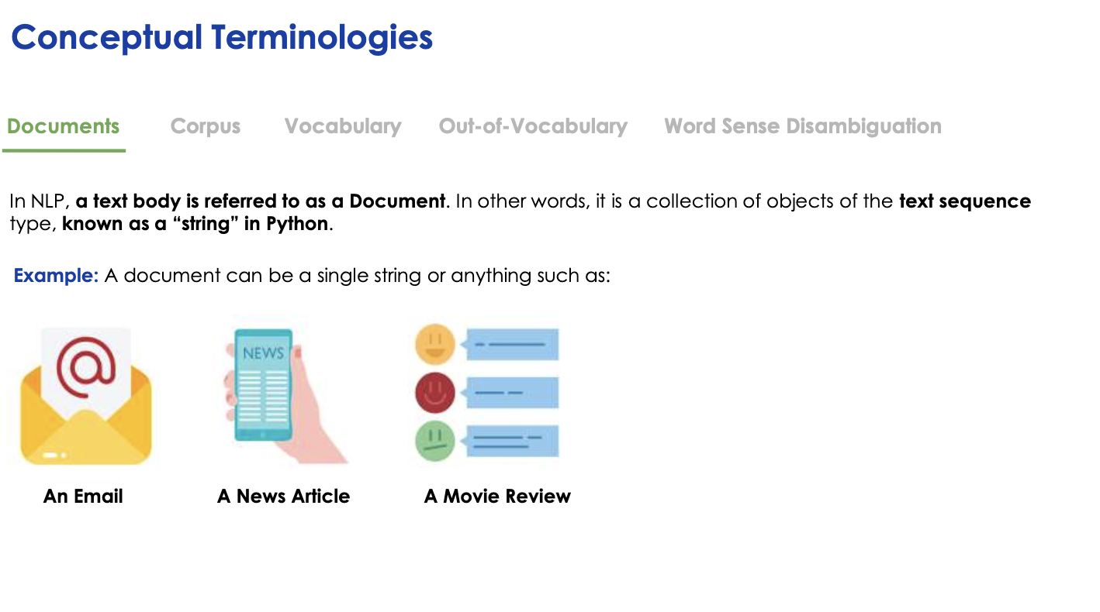

Slide 26
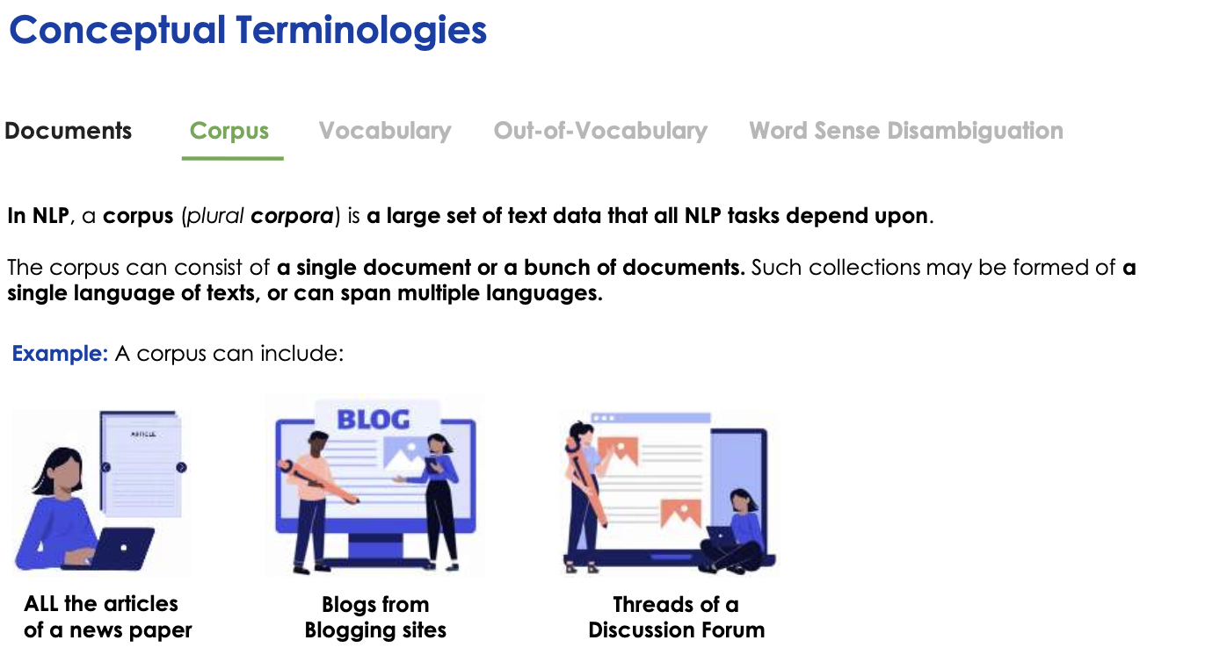

Slide 27
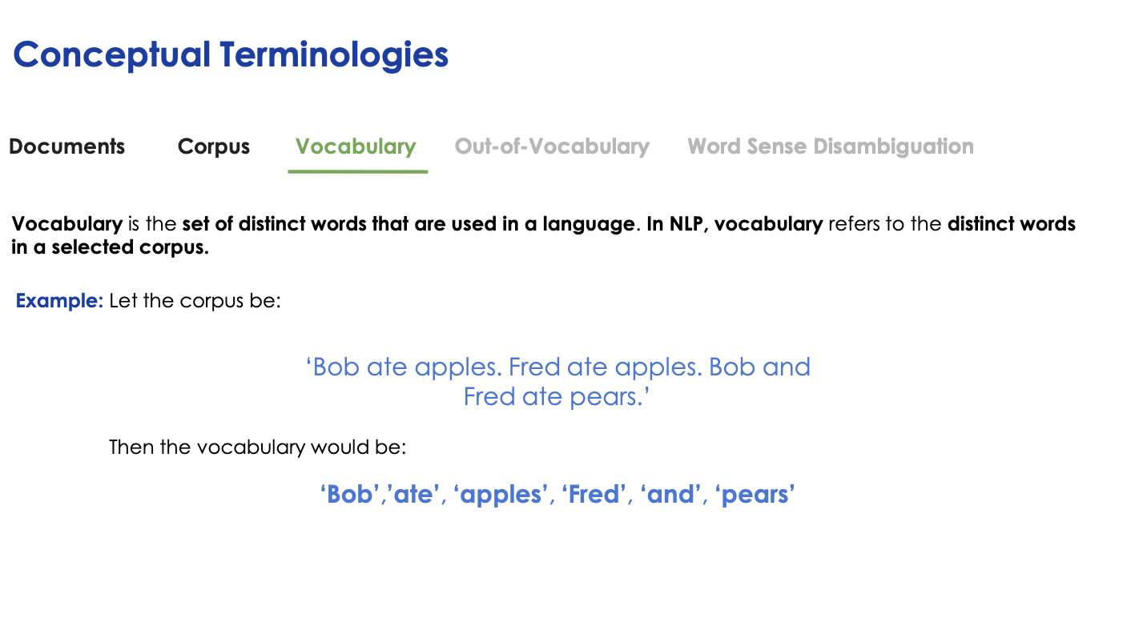

Slide 28
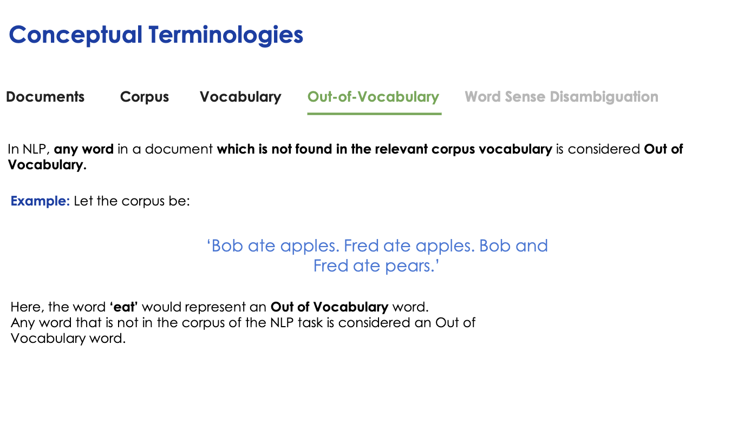

Slide 29
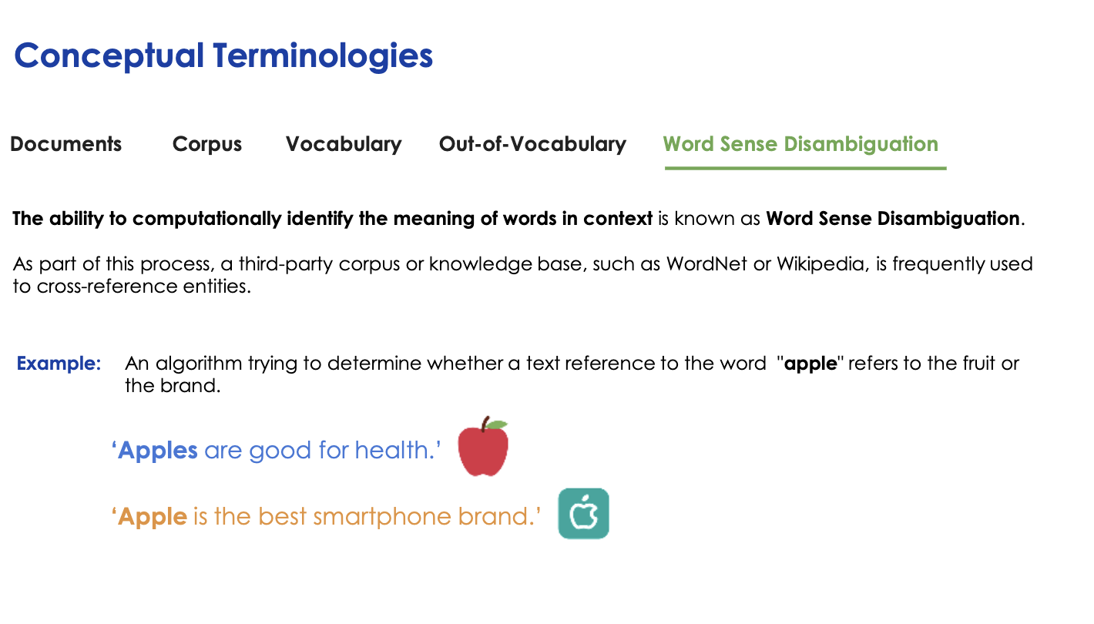

Slide 30
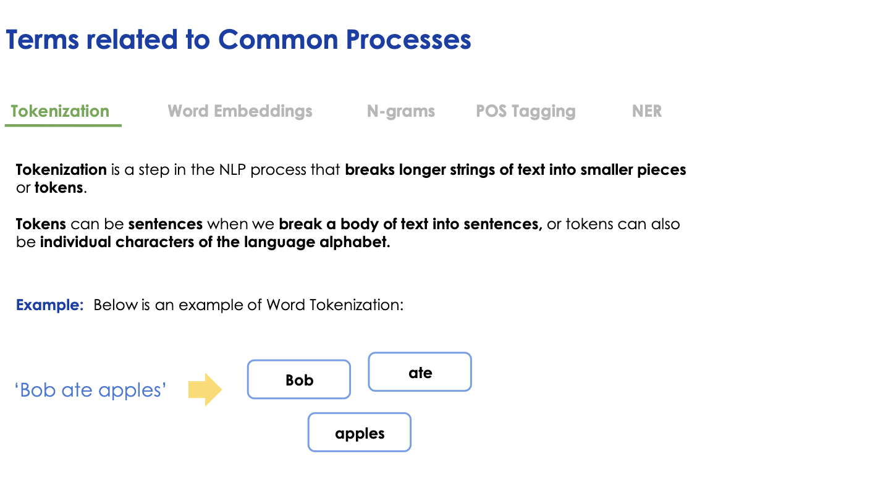

Slide 31
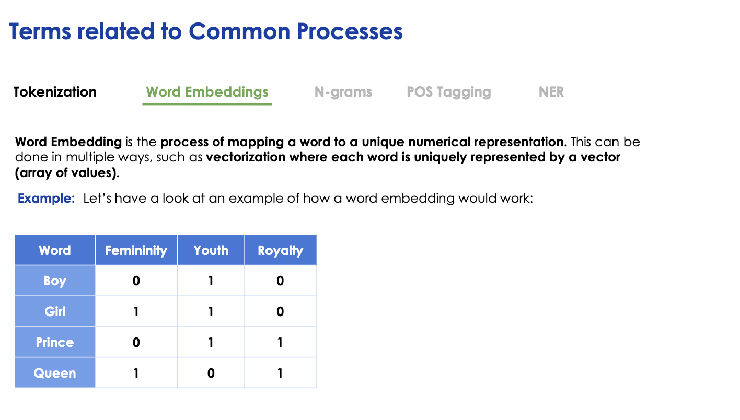

Slide 32
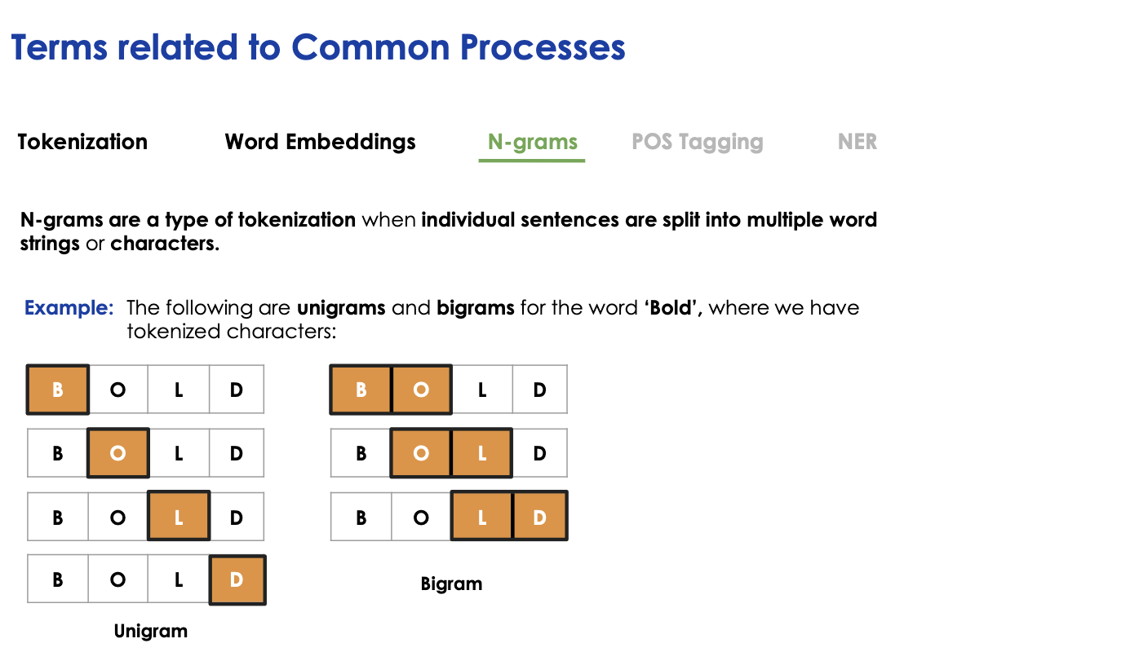

Slide 33
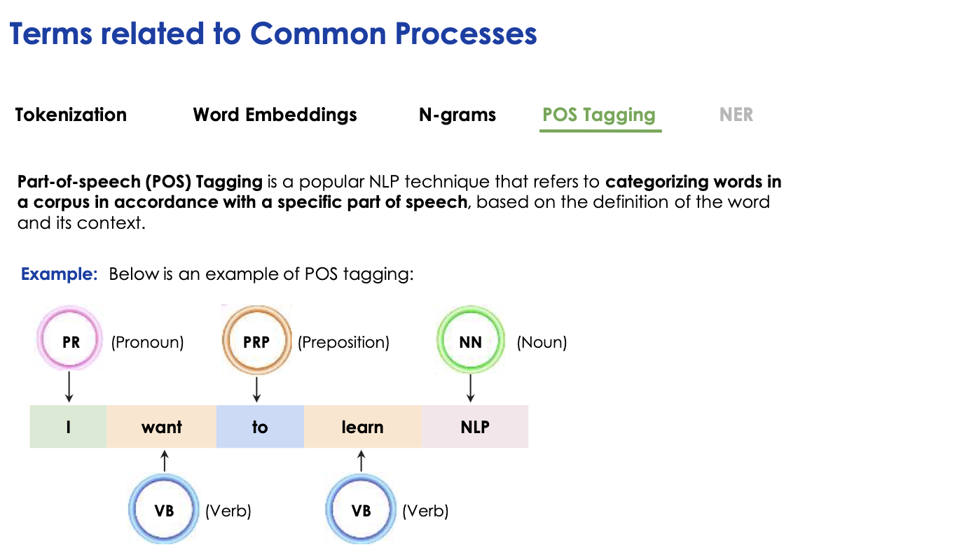

Slide 34
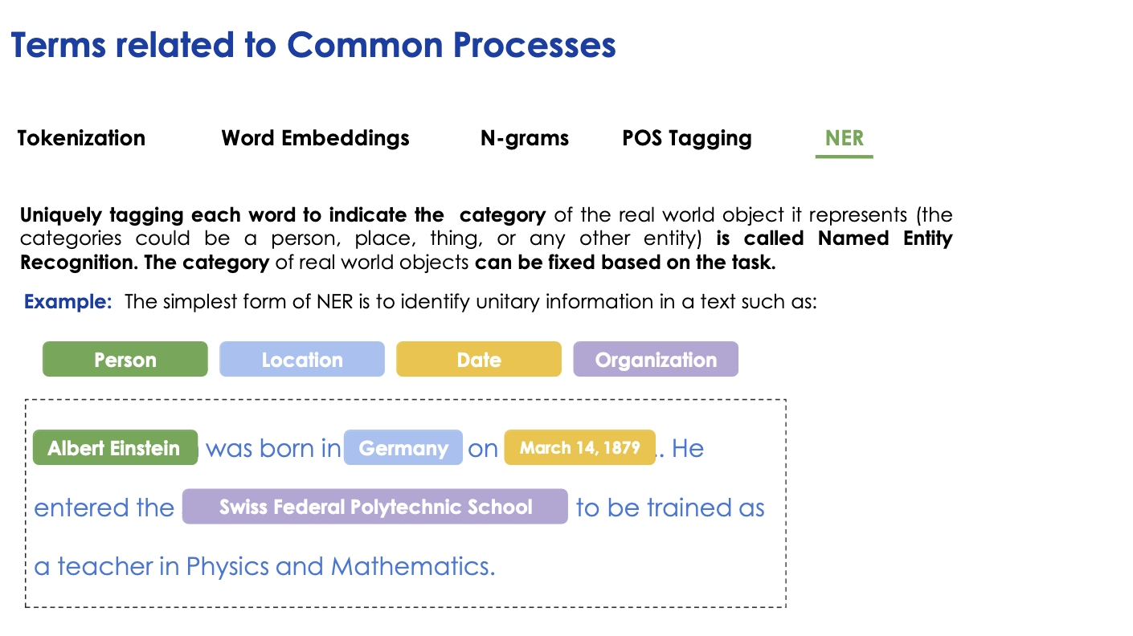

Slide 35
TASKS IN VARIOUS NLP PROBLEMS

Slide 36
TASKS IN DIFFERENT NLP PROBLEMS
Corpus 🡪 Extract documents
● Document 🡪 Extract sentences
● Sentences 🡪 Extract tokens
● Tokens 🡪 Normal, stem, lemma forms
● Sentence, tokens 🡪 PoS tagging, NER ( named entity recognition – Obama, Einstein, Manhattan )
● Sentence, tokens 🡪Parsing, e.g. chunking, chinking, syntax tree
● Document 🡪 Classification, e.g. sentiment analysis, topic extraction
● Sentence 🡪 Text synthesis, e.g. translation, Q&A

Slide 37
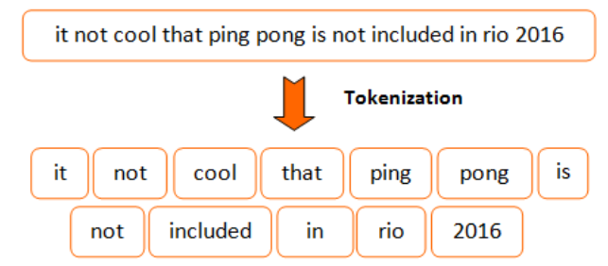
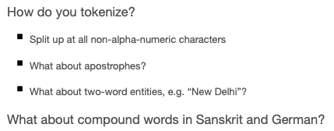
TOKENIZATION
Tokenization is the task of taking a text or set of text and breaking it up into its individual tokens.
Tokens are usually individual words (at least in languages like English).
Tokenization can be achieved using different methods. Most common method is Whitespace tokenizer and Regexp Tokenizer. We will use them in our case study.

Slide 38
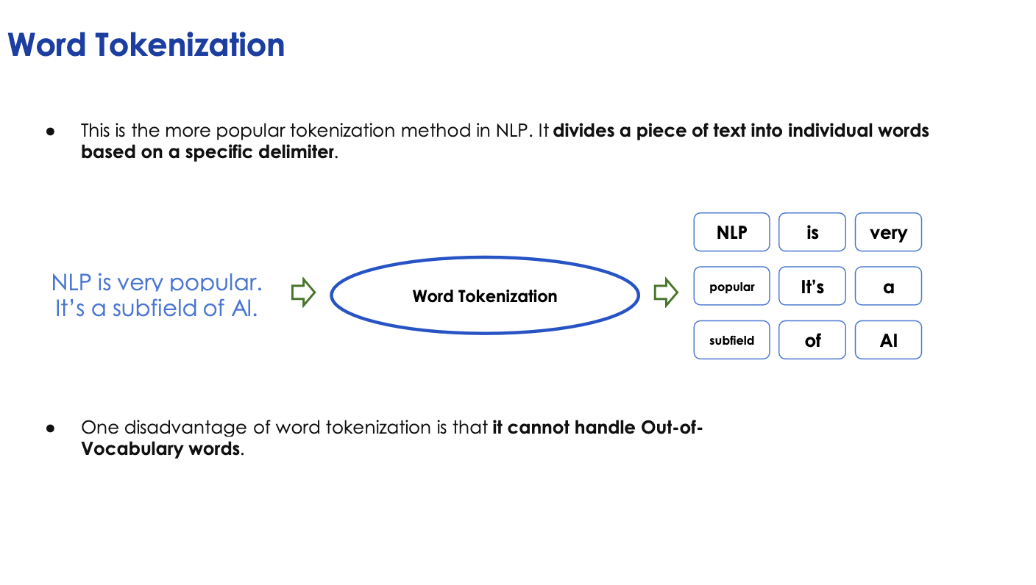

Slide 39
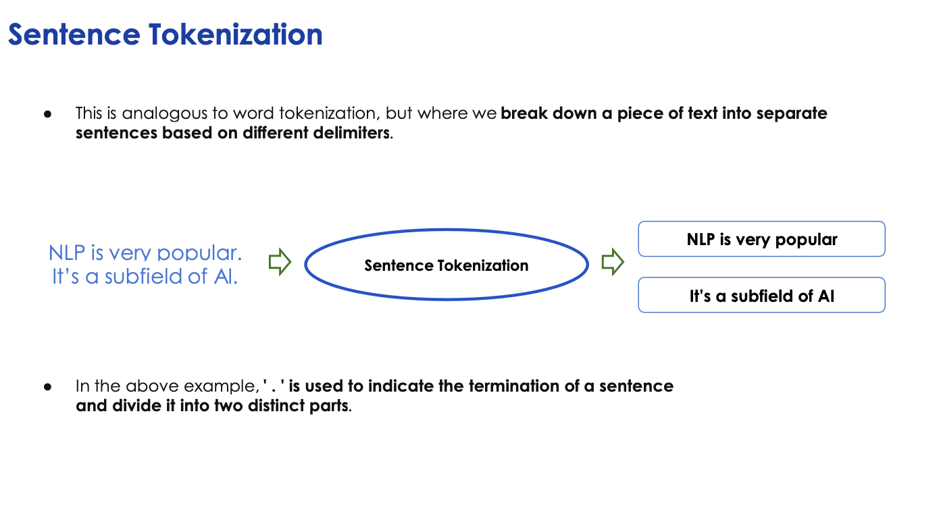

Slide 40
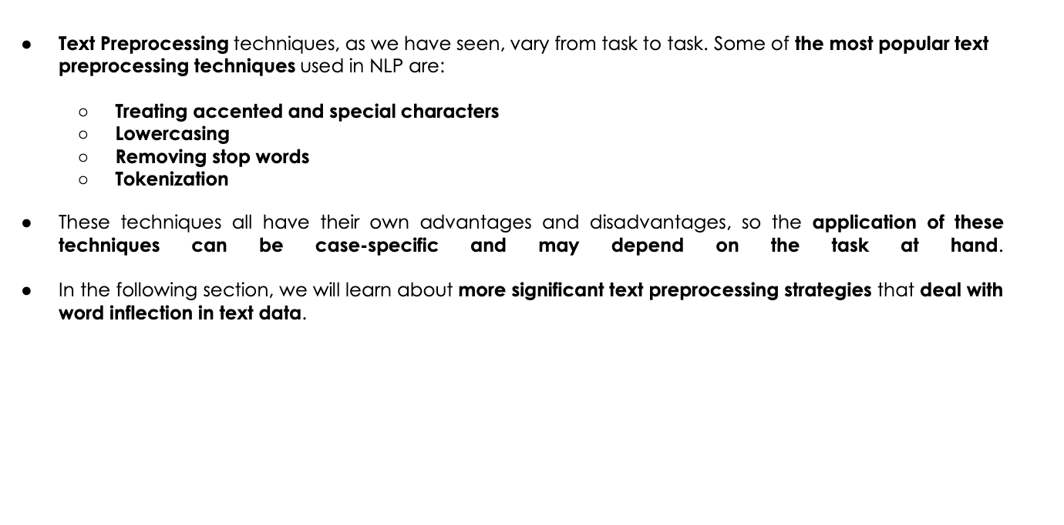

Slide 41
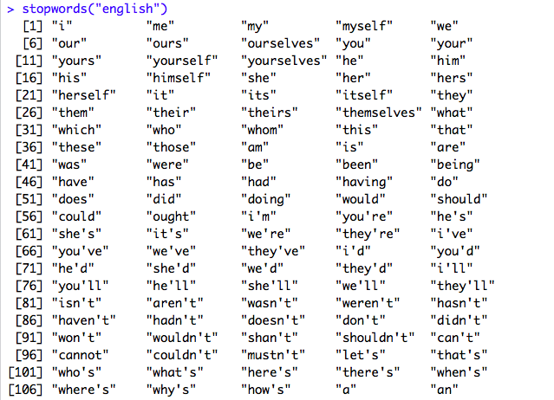
STOP WORDS REMOVAL
Stopwords are common words that carry less important meaning than keywords.
When using some bag of words based methods, i.e, countVectorizer or tfidf that works on counts and frequency of the words, removing stopwords is great as it lowers the dimensional space.
Not always a good idea?
When working on problems where contextual information is important like machine translation, removing stop words is not recommended.

Slide 42
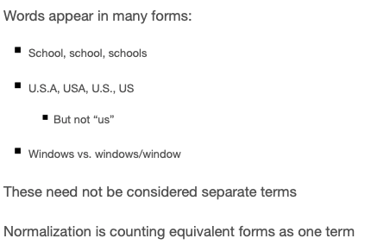
NORMALIZATION

Slide 43
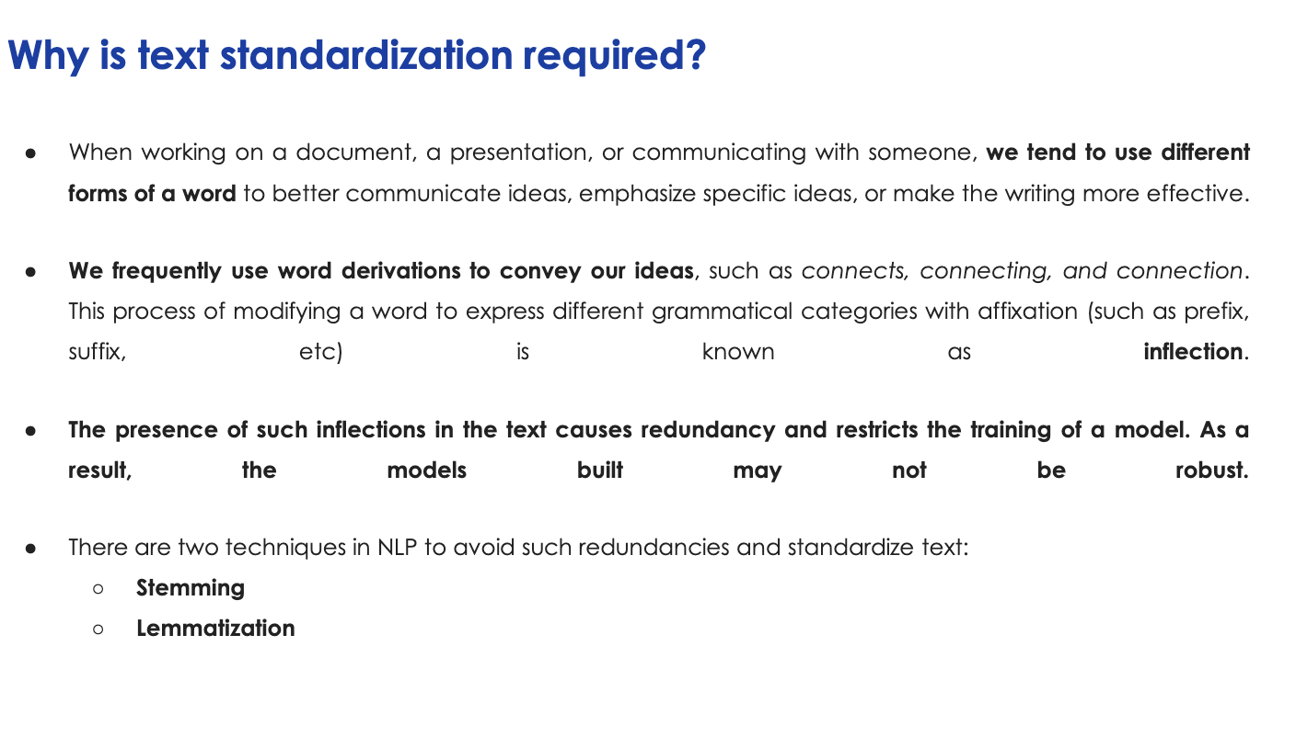

Slide 44
STEMMING AND LEMMATIZATION
The idea of reducing different forms of a word to a core root.
Words that are derived from one another can be mapped to a central word or symbol, especially if they have the same core meaning.
In stemming, words are reduced to their word stems. A word stem is an equal to or smaller form of the word.
“cook,” “cooking,” and “cooked” all are reduced to same stem of “cook.”
Lemmatization involves resolving words to their dictionary form. A lemma of a word is its dictionary or canonical form!
STEMMING is RULE based
Lemmatization is like how humans created and understand language.
It is computationally intensive.

Slide 45
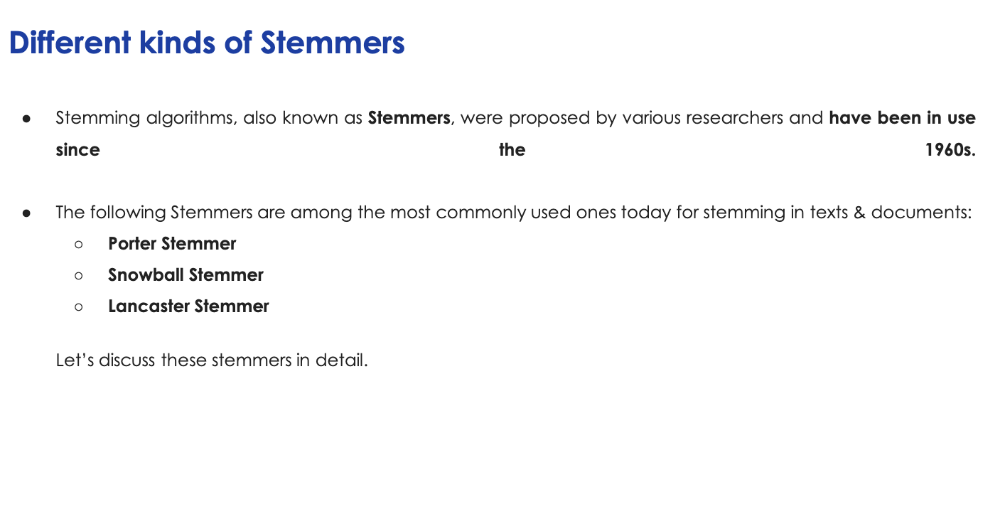

Slide 46
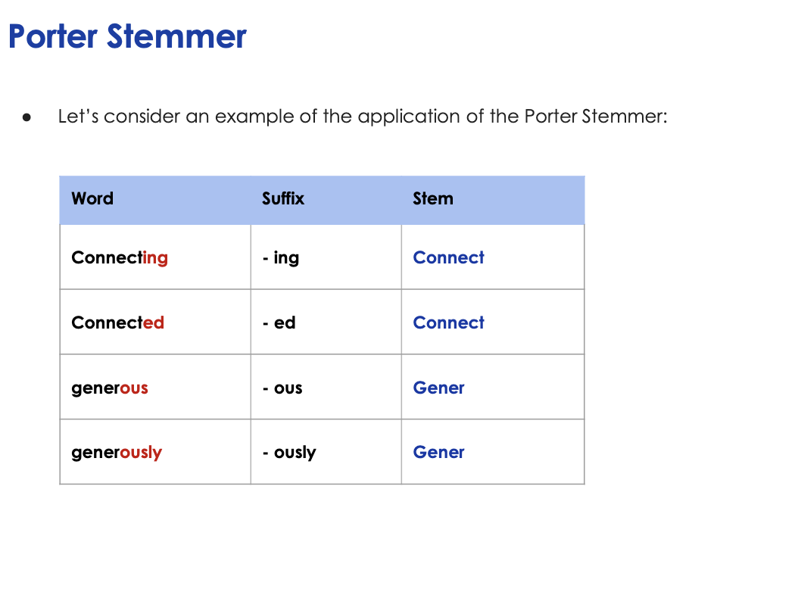

Slide 47
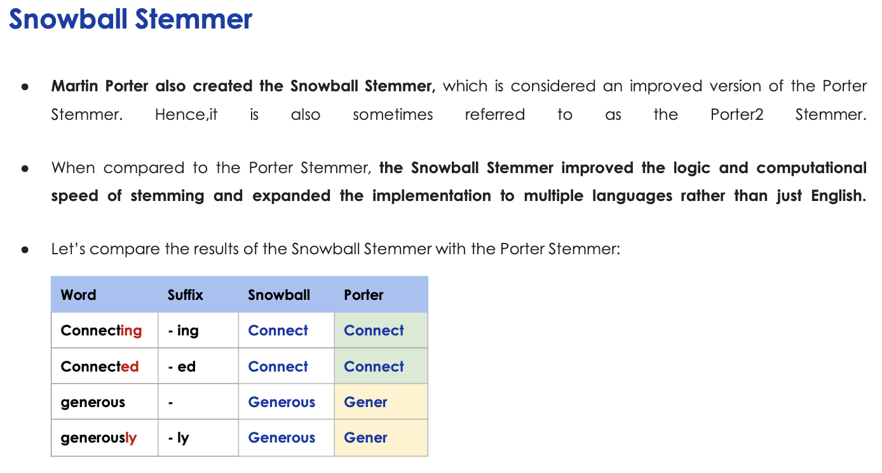

Slide 48
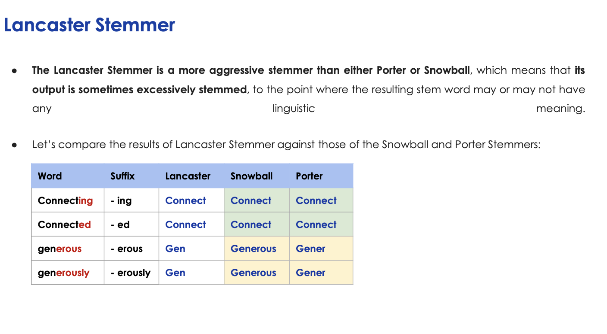

Slide 49
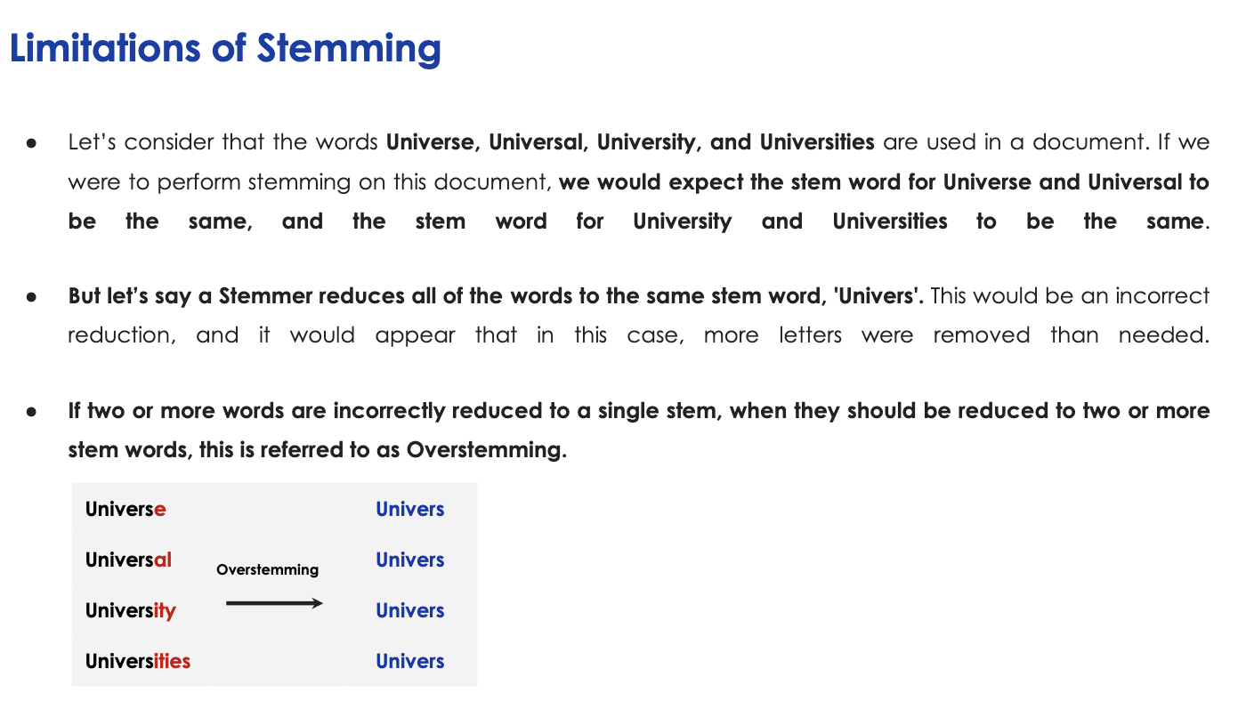

Slide 50
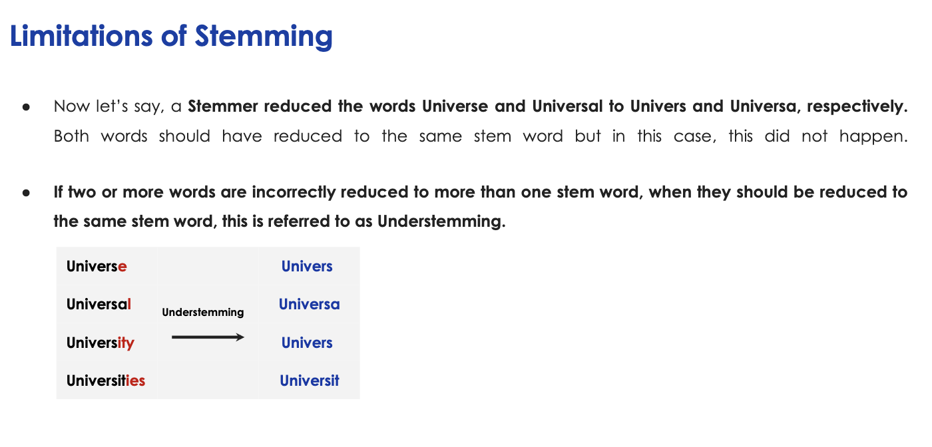

Slide 51
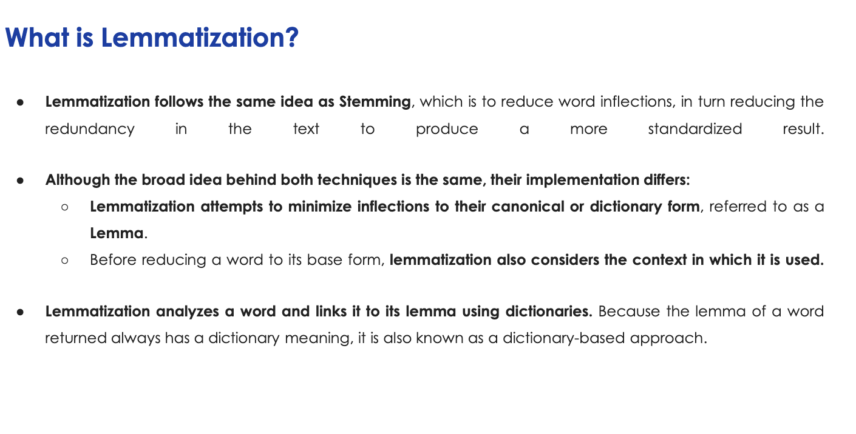

Slide 52
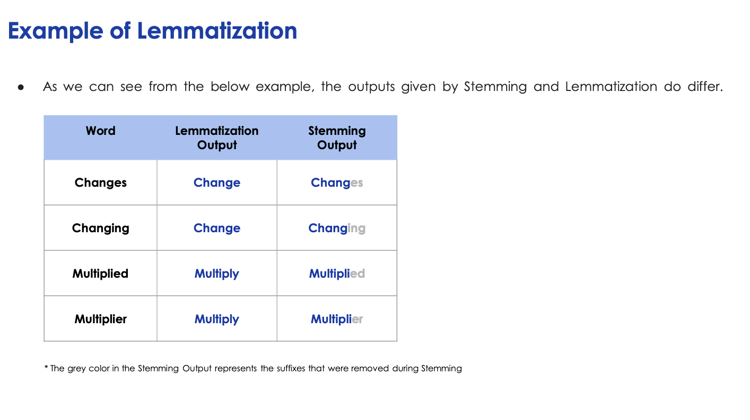

Slide 53
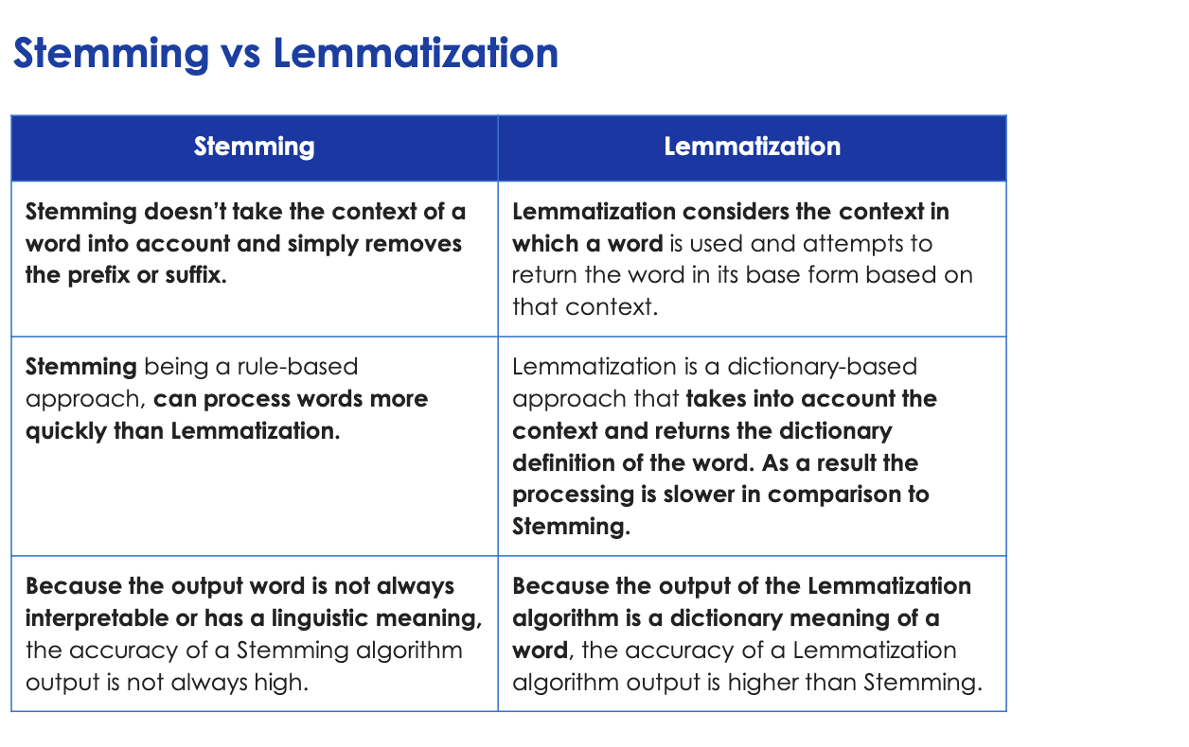

Slide 54
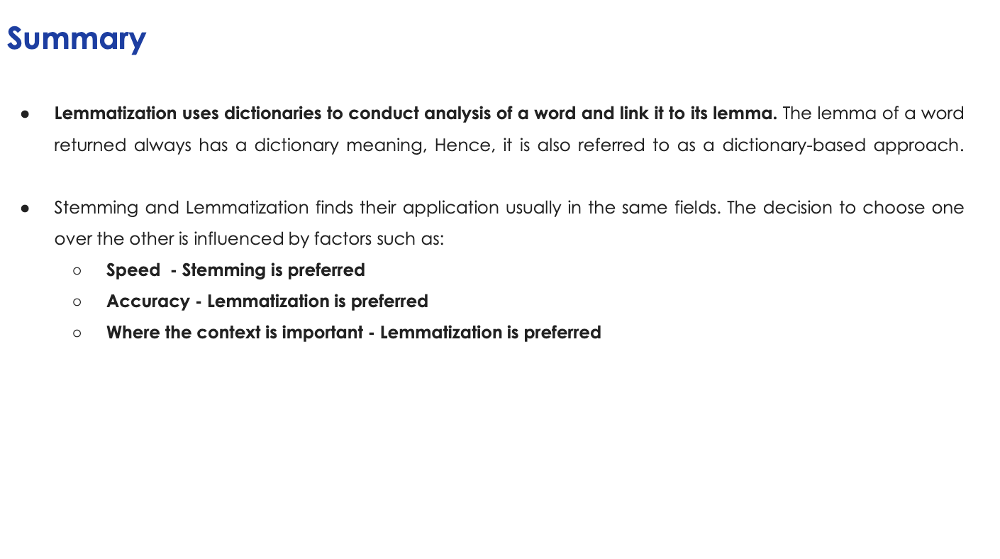

Slide 55
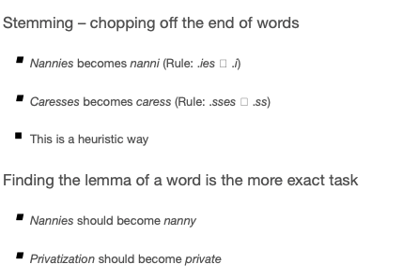
STEMMING AND LEMMATIZATION - EXAMPLES

Slide 56
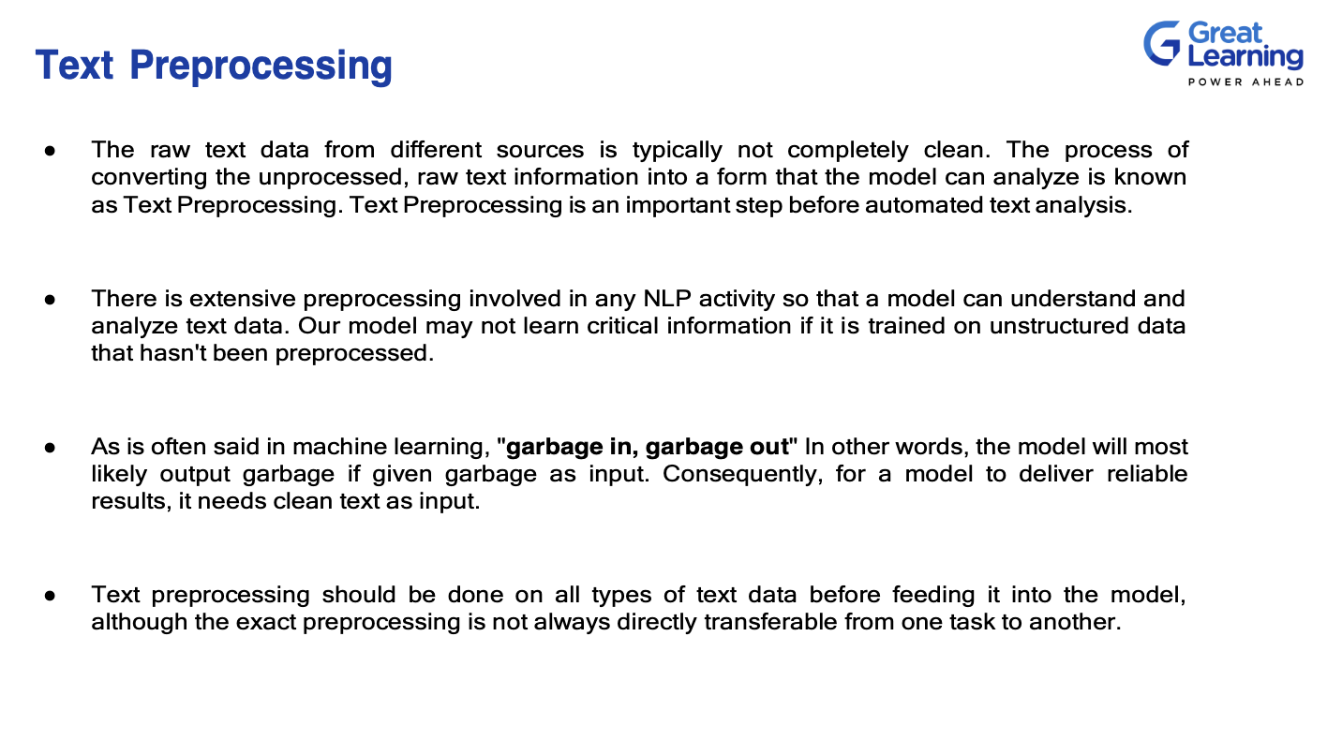

Slide 57
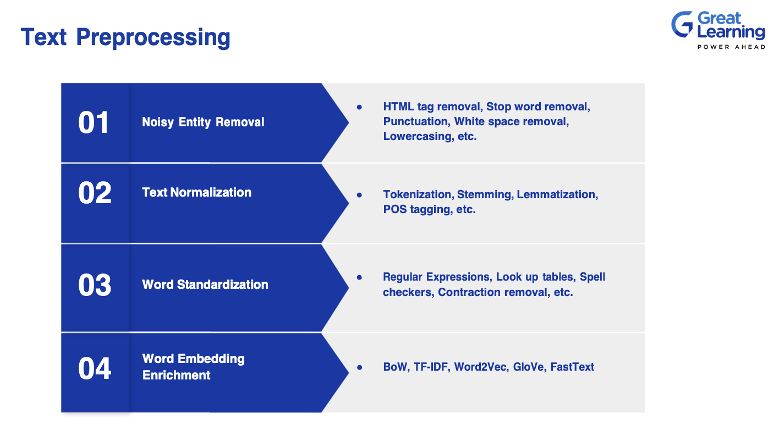

Slide 58

LIBRARIES

Slide 59
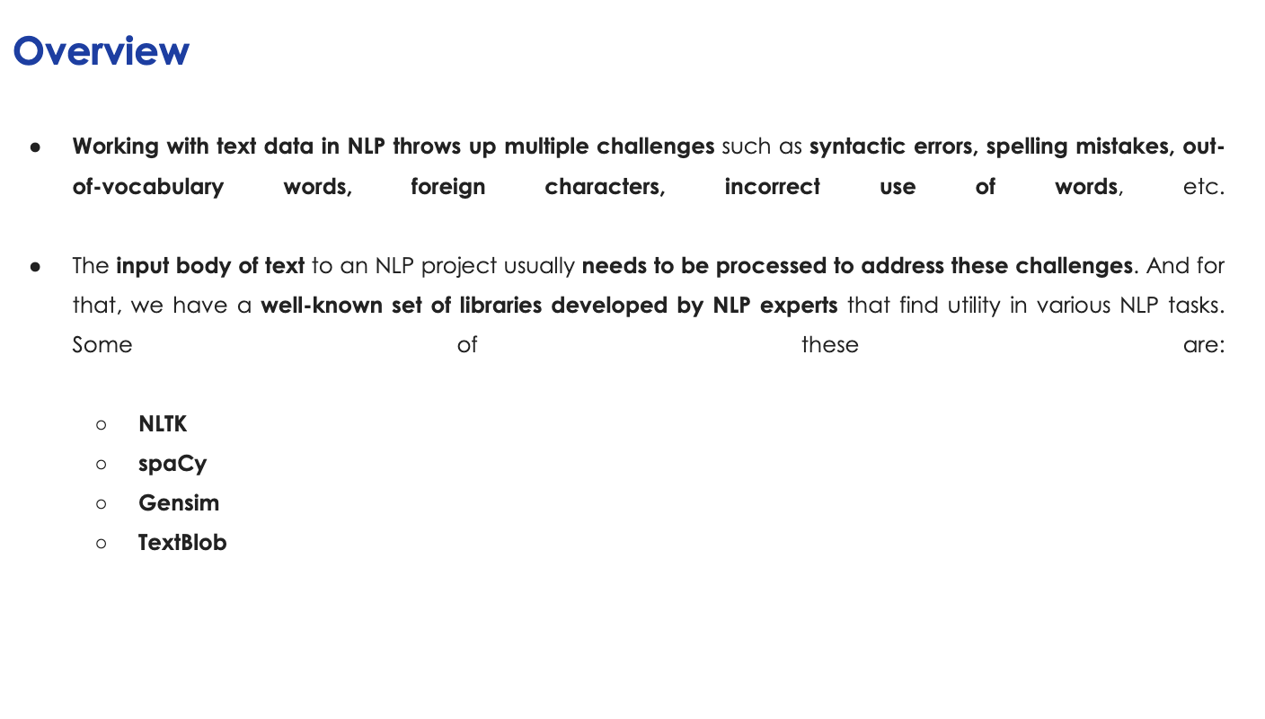

Slide 60
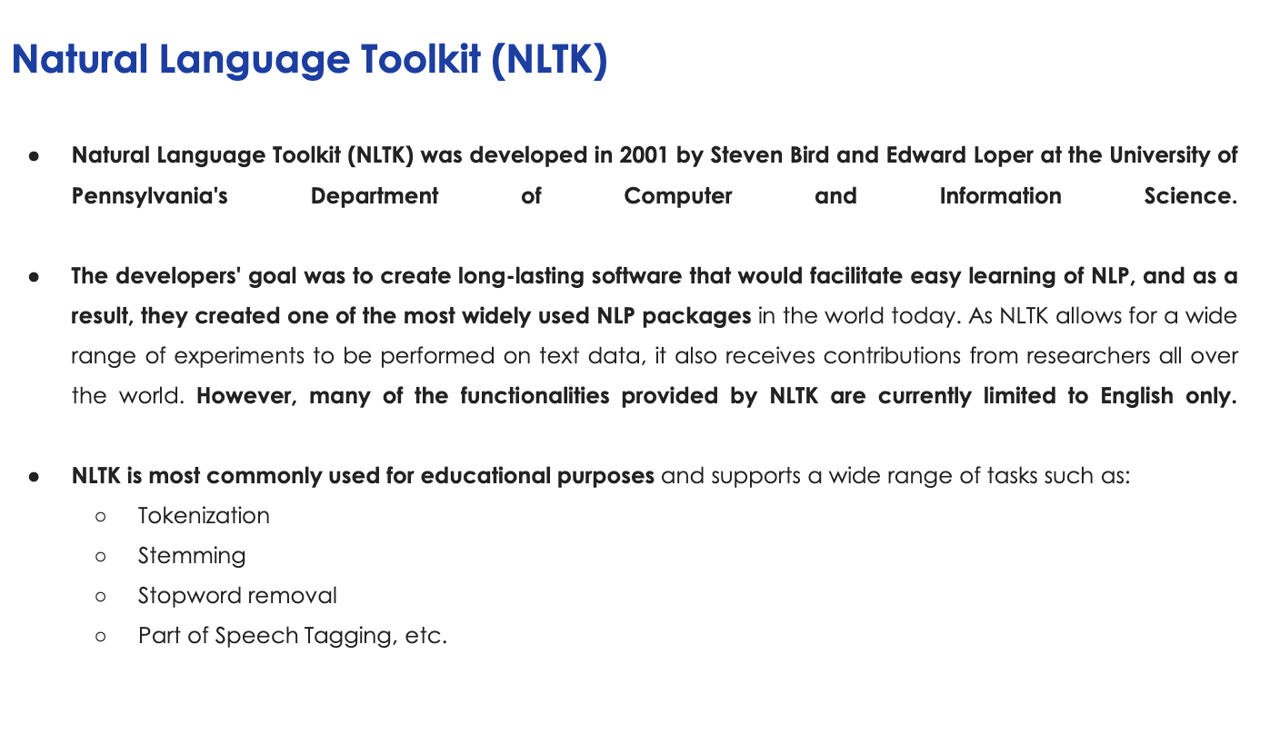

Slide 61
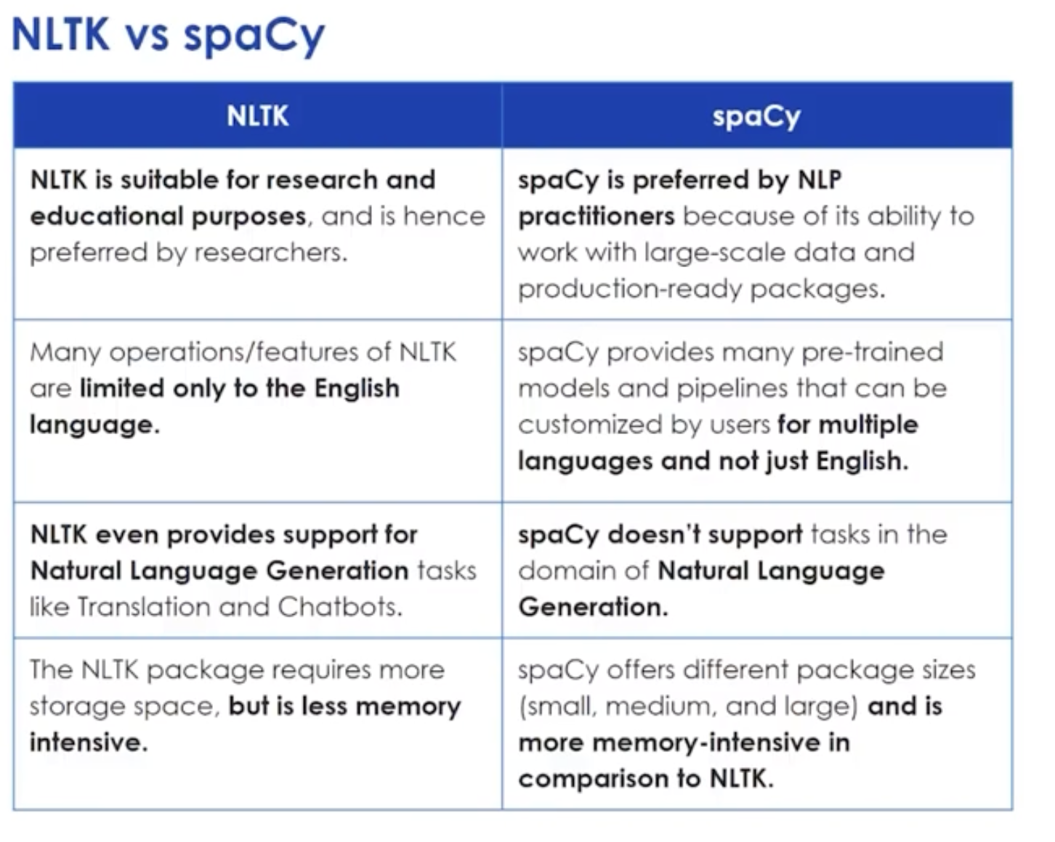

Slide 62
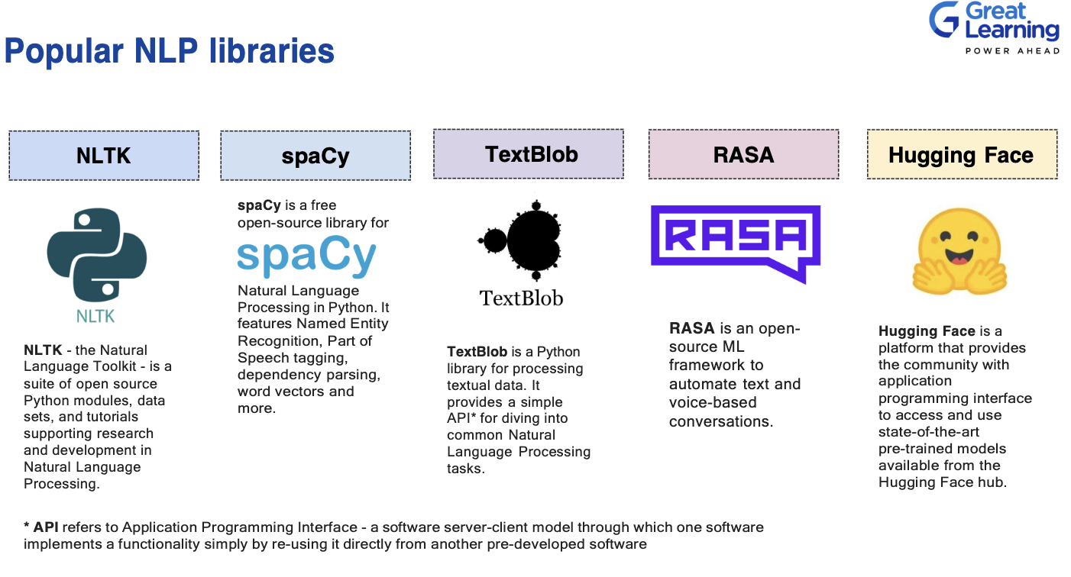

Slide 63
WORD FEATURES

Slide 64
WORD VECTORS
Now once we had the corpus, we got sentences, then tokens and then normalized or did stemming or lemmatization etc.
However can we use that directly in NLP Model ?
NO, We cannot input the text data to the NLP model directly.
Hence we need to convert words into Vectors.

Slide 65
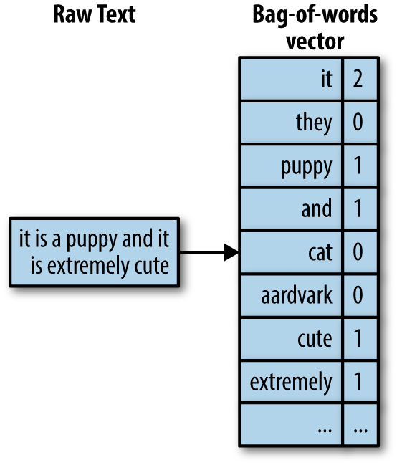
BAG OF WORDS
In this model, a text (such as a sentence or a document) is represented as the bag of its words, disregarding grammar and even word order but keeping multiplicity.
We use the tokenized words for each observation and find out the frequency of each token.
We define the vocabulary of corpus as all the unique words in the corpus above and below some certain threshold of frequency.
Each sentence or document is defined by a vector of same dimension as vocabulary containing the frequency of each word of the vocabulary in the sentence.
The bag-of-words model is commonly used in methods of document classification where the (frequency of) occurrence of each word is used as a feature for training a classifier.

Slide 66

TF-IDF VECTORS
TF-Idf (Term frequency times Inverse Document Frequency) is a scheme to weight individual tokens.
One of the advantage of tf-idf is reduce the impact of tokens that occur very frequently, hence offering little to none in terms of information.

Slide 67


Slide 68

AFTER CONVERTING WORDS TO FEATURES

Slide 69

BASIC TEXT CLASSIFICATION USING ML

Slide 70
AFTER LEARNING HOW TO CLASSIFY THE DOCUMENTS CAN YOU PREDICT THE NEXT WORD ? LANGUAGE MODEL VS CHANNEL MODEL

Slide 71

LANGUAGE MODEL
When someone is speaking up and if he or she stops.. You would already know that when would be the next word ☺

Slide 72

A PROBABILISTIC MODEL OF LANGUAGE

Slide 73

CONTEXT
Friendly is positive
But context wise it is negative

Slide 74


Slide 75


N-GRAM AND LANGUAGE MODEL
Language models are the type of models that assign probabilities to sequence of words.
N-grams is the most simplest language model. It’s a sequence of N-words.
Bi-gram is a special case of N-grams where we consider only the sequence of two words (Markovian assumption ).
In N-gram models we calculate the probability of Nth words give the sequence of N-1 words. We do this by calculating the relative frequency of the sequence occurring in the text corpus.

Slide 76

MARKOVIAN ASSUMPTIONS.
We cannot keep on increasing the n value in n-grams. As it can grow exponentially.
So using the generic Markovian assumption, we only try to predict the next word only with previous some values and not

Slide 77

WE CAN LEARN N-GRAMS BETTER FROM THE CORPUS TO GET BETTER PREDICTIBILITY

Slide 78
CHANNEL MODEL : SOME MISTAKES ARE MORE LIKELY THAN OTHERS.

Slide 79


Slide 80

HOW TO CALCULATE

Slide 81
BAYES TO RESCUE AGAIN !

Slide 82

BAYES THEOREM AT RESCUE
W = Chosen Word for replacement from the vocabulary
W’ = User Typed Word
F = Context
Language Model will given us the probability of the chosen word W given the context F what is.
Channel Model will then tell us that given the correct word what is the probability of someone typing the incorrect word W’
Whichever combination gives us better probability value, that word W will be used to replace the incorrect word W’

